Slide 1
Wickes Manufacturing TCE Plume Custer Township Hall November 3, 2022
Janice Adams
Remediation and Redevelopment Division
989-619-4211 | Adamsj1@michigan.gov
Len Mankowski
WSP USA
231-218-0551 | leonard.mankowski@wsp.com

Slide 2
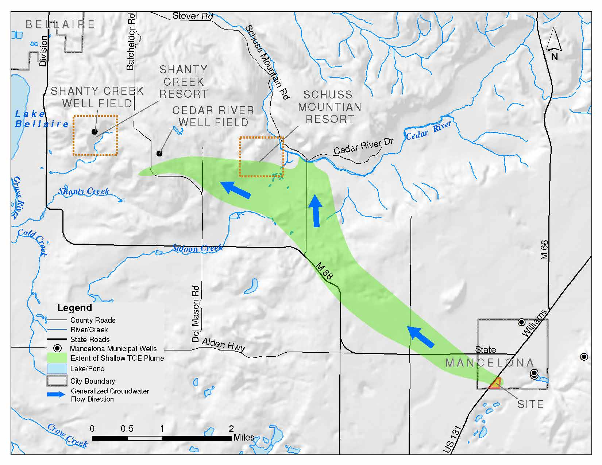
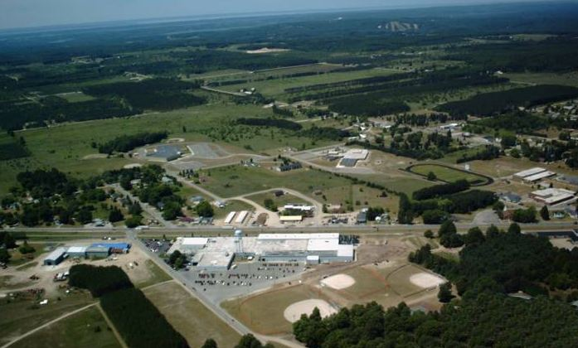
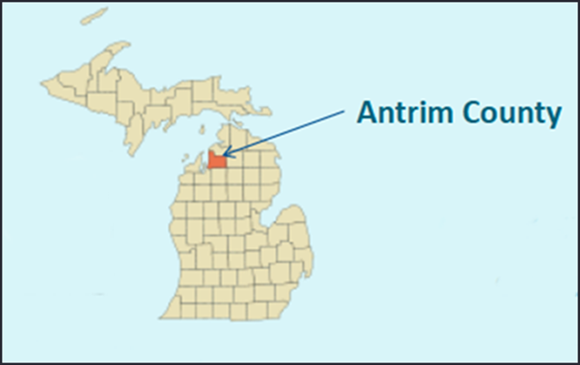
Wickes Manufacturing Trichloroethylene (TCE) Plume
SCHUSS Mtn.
SITE
From upnorthlive.com - archive

Slide 3
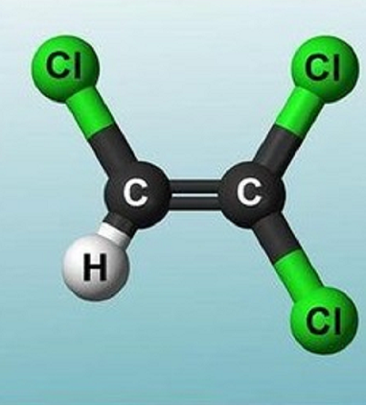
What is TCE?
Trichloroethylene (aka trichloroethene/TCE)
Man-made solvent (synthetic) used especially in industrial processes (e.g., metals cleaning and degreasing)
TCE was used extensively in industry between the 1920s and 1970s
TCE is still used today on a limited basis
TCE is volatile and in its “raw” form is denser than water
Known human carcinogen
Noncarcinogenic health effects (e.g., Liver/Kidney)

Slide 4
At What Groundwater Concentration Does TCE Pose a Health or Environmental Risk?
Drinking water – TCE levels above 5 micrograms per liter (parts per billion - “ppb”) are unsafe
Surface Water (GSI) - TCE levels above 200 ppb are unsafe for aquatic ecosystems.

Slide 5
Just How Much is a ppb?
1 inch in 16,000 miles
1 second in 32 years
1 penny in $10,000,000
1 pinch of salt in 10 tons of potato chips
1 square foot in 36 square miles
1 heartbeat over 27 years of your adult life
1 drop of TCE in a swimming pool

Slide 6
History of Wickes Manufacturing Site
Wickes Manufacturing Site located in Mancelona, MI
1947 to 1967 operated by Mt. Clemens Metal Products
1967 to 1985 operated by Gulf and Western
1985 to 1990 operated by Wickes Manufacturing
1986 EGLE and EPA become involved following discovery of TCE in groundwater and drinking water
1990 to 2008 operated by DURA Automotive
2003 Wickes Manufacturing Site becomes state funded
2011 Plant was demolished
Records indicate TCE was only used up until the mid 1960s

Slide 7
Key EGLE-Lead Investigations
2006 Soil Investigation & 2017 Soil & Soil Vapor Investigations onsite
2004 and 2007 vertical aquifer sampling (VAS) to define plume from water table to depths of nearly 600 feet below ground surface (Basal till)
Geophysical surveys to assess groundwater plume, geologic layering and source area
Resistivity / Induced Polarization transects
P- and S-Wave Seismic Surveys
Frequency domain electromagnetics (EM-31)
Ongoing groundwater monitoring and sentinel well network expansion
Cedar River Well Field (CRWF) pumping studies
Surface water/pore water sample collection (Cedar River)
Stream gauging (Shanty Creek)
Ongoing vapor assessments (source area and downgradient plume)

Slide 8
Shallow Groundwater Plume – Impacts
The shallow groundwater TCE plume is approximately 1.5 miles wide and extends over 6.5 miles to the northwest of the site
A portion of the plume discharges or “vents” to the Cedar River
TCE in groundwater has affected over 500 residential drinking water wells and some former shallow community drinking water supply wells

Slide 9
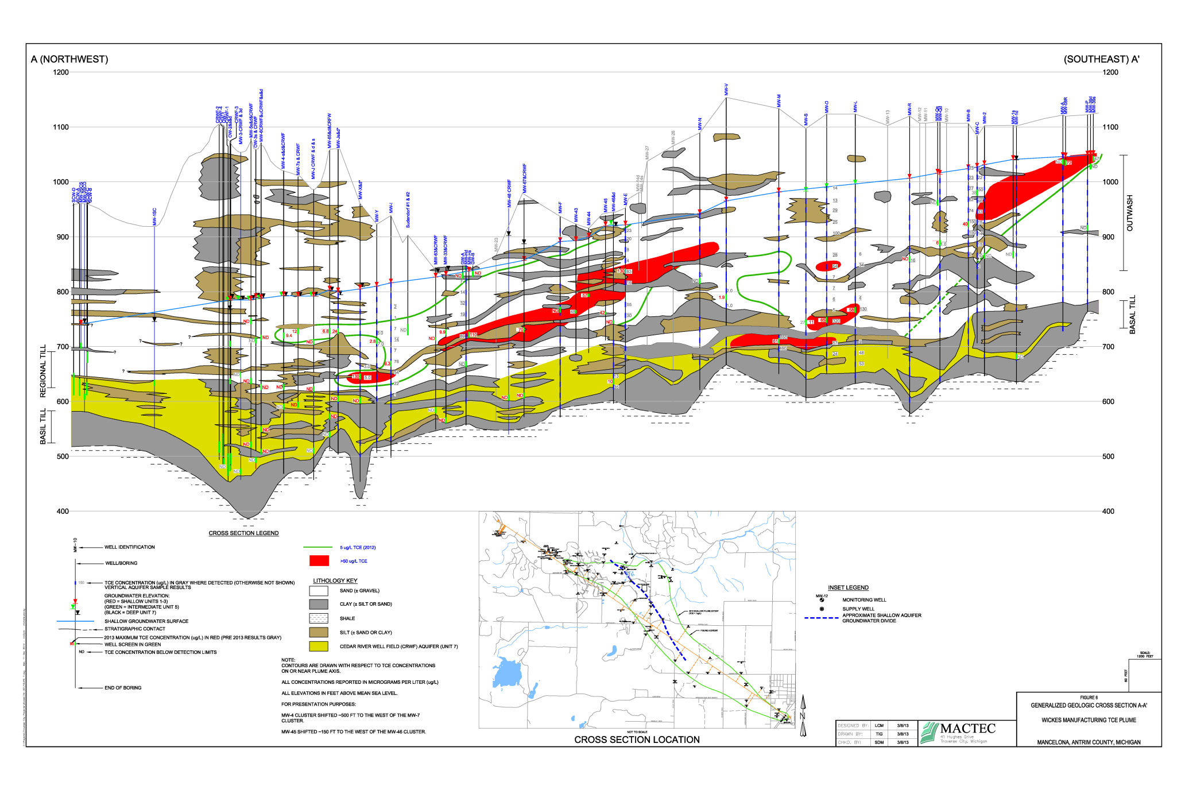
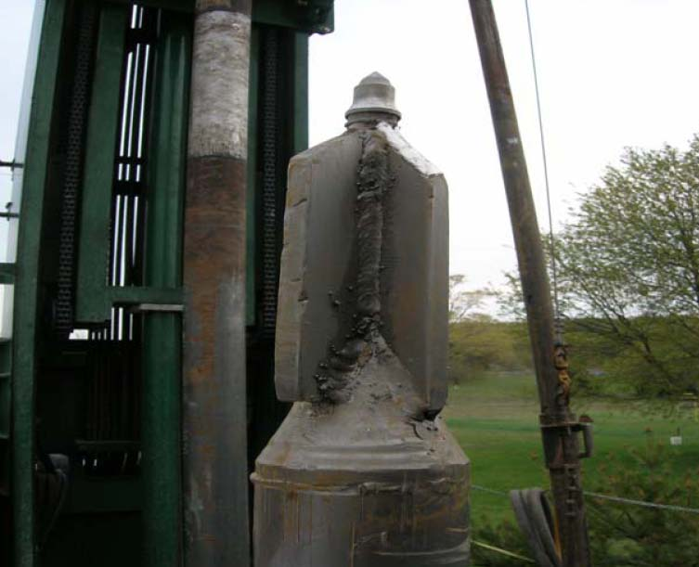
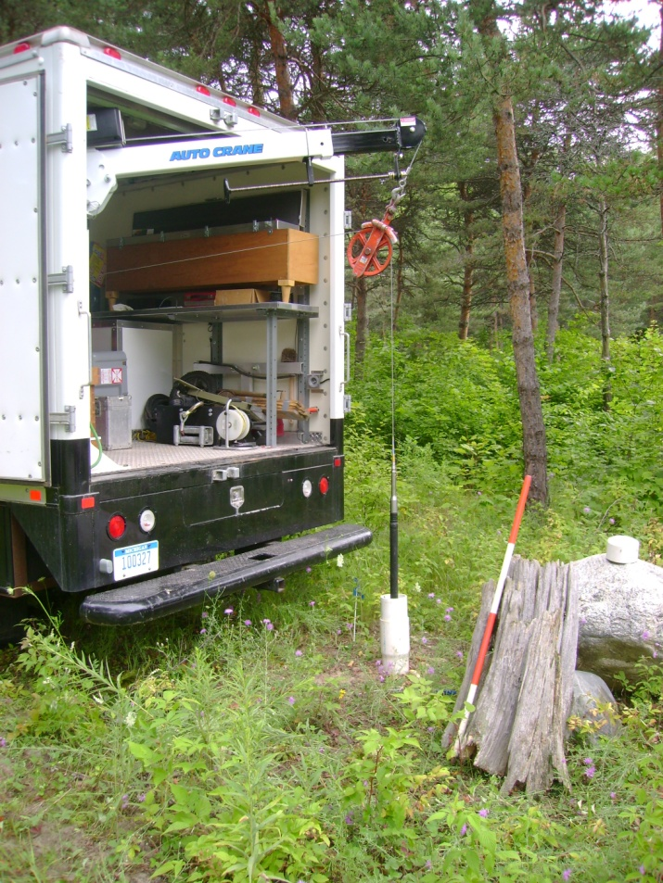
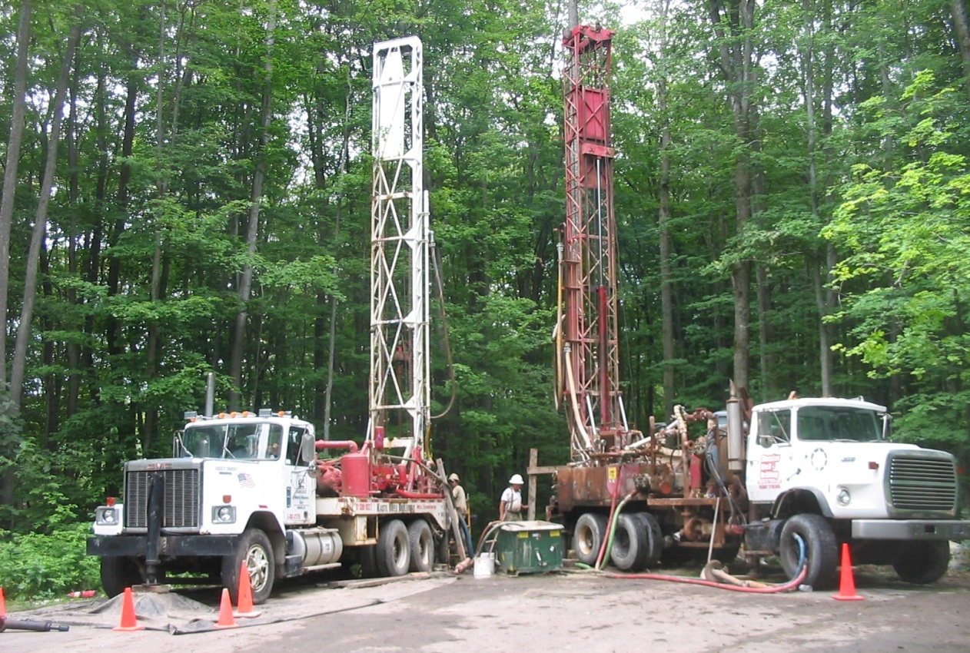
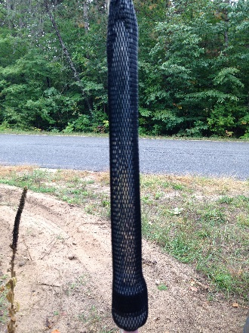
Downgradient Groundwater Investigations
EGLE investigations begin in 2003
Investigations moved from the plant area to the northwest based on groundwater flow
Rotosonic vertical aquifer sampling (VAS)
Mud rotary wells with gamma logging
Current Groundwater Monitoring Program
147 monitoring wells and 4 stream gauges gauged to understand groundwater flow
2x year sample collection (~ 42-50 wells per event)
Annual sample collection at the Cedar River
The Health Department of Northwest Michigan (HDNM) regularly samples potentially at-risk residential wells (53 in 2022; 60 in 2023)
Rotosonic “Power Punch” VAS Tool
Mud rotary rigs – nested well installs
Passive diffusion bag
Gamma logging

Slide 10
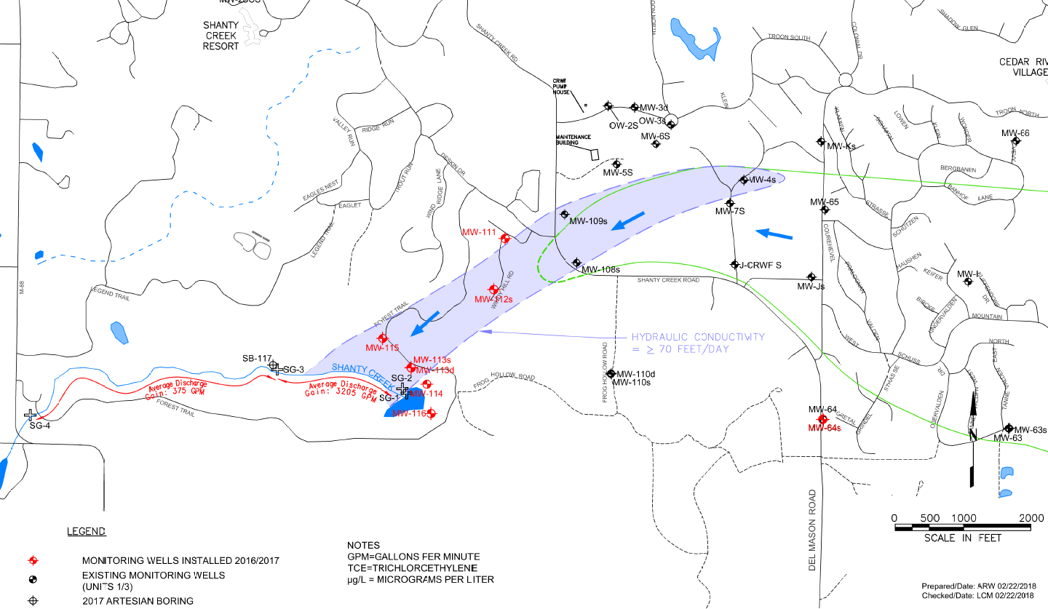
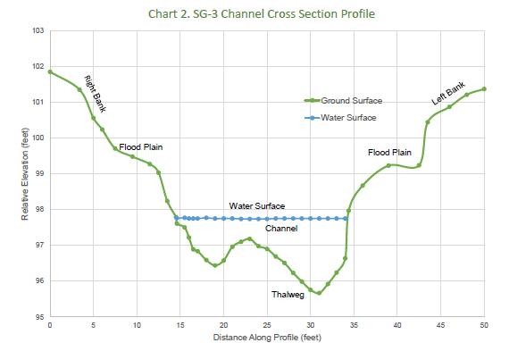
Shanty Creek Stream Gauging (2017)
Potential preferential pathway to groundwater venting area
Assess potential preferential pathways/future venting to Shanty Creek
Seasonal gauging at fixed locations
Hydraulic conductivity assessment (slug testing)
Average “gain” (groundwater discharge) between pond and SG-3 ~3,200 gallons per minute
Plume
SG-3

Slide 11
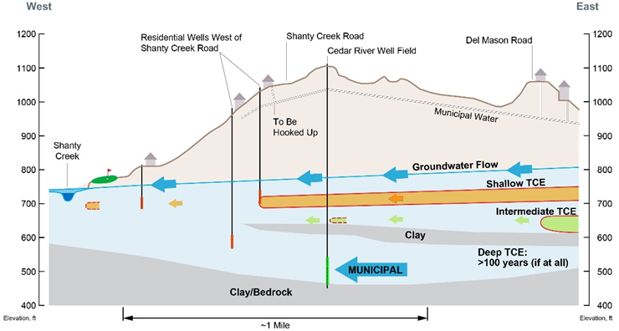
Groundwater System
TCE extends vertically within outwash/glacial groundwater system
Shallow zone: Impacts typically occur at 50 to 100 feet below the water table. Contaminant migration rate of 300-400 feet per year. Residential wells typically draw water from similar depths where shallow zone TCE is known to occur.
Intermediate Zone: Contaminant migration rate of ~100 feet per year.
Deep Zone: Contaminant migration rate of <50 feet per year. The Cedar River Well Field (CRWF) is installed in this portion of the aquifer. Where detected, TCE tends to be discrete (not forming a mappable plume).
Deep TCE
(Discrete)

Slide 12
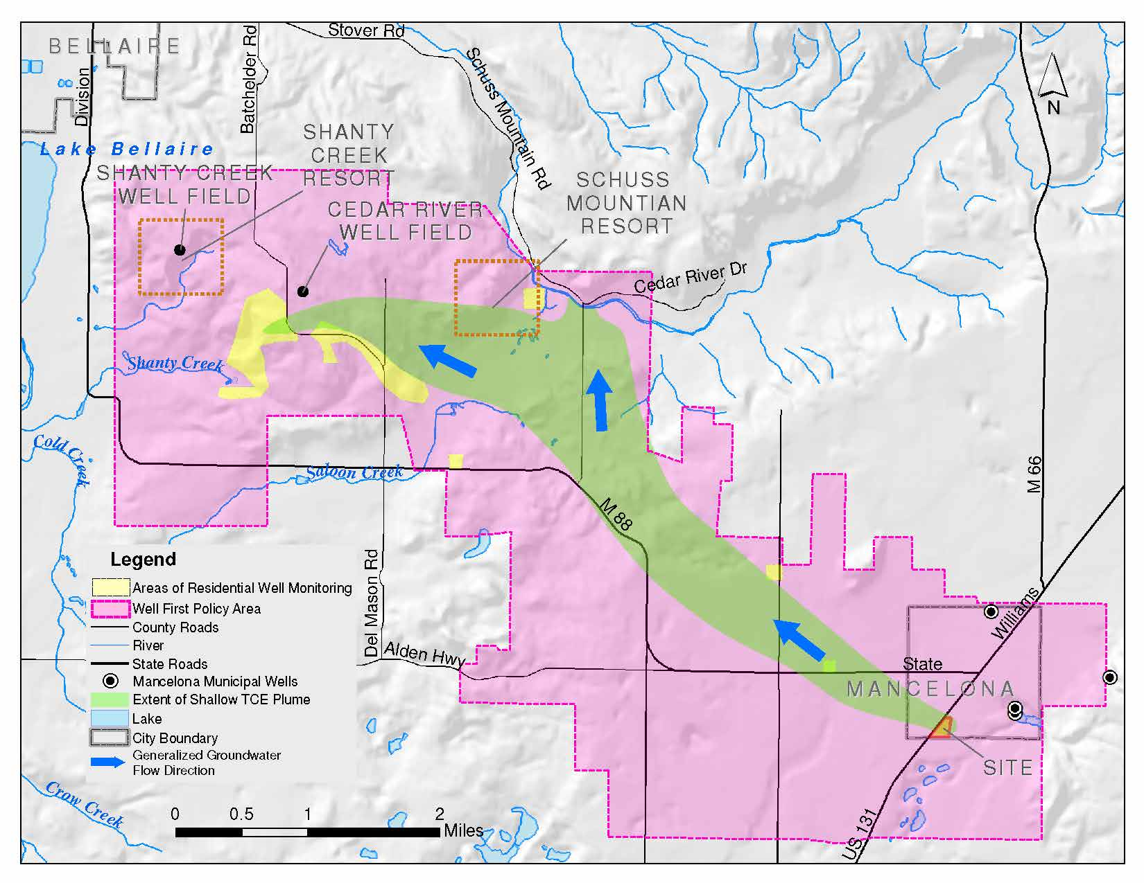
Preventing Drinking Water Exposure
Provide a Safe Source of Drinking Water
Mancelona Area Water and Sewer Authority (MAWSA) operates the public water system and was founded to prevent exposure to TCE in residential wells in the Mancelona Area
The MAWSA service area has expanded based on monitoring/residential well sample results
HDNW Well First Policy – Look before you leap
Permit process to prevent unintended exposure to TCE
Implemented in 2005 with approval from the Board of Health and support from the EGLE, MAWSA and ACUTE (Community Group)
Extended policy areas in 2012 & 2018 in response to plume and MAWSA service area expansions

Slide 13
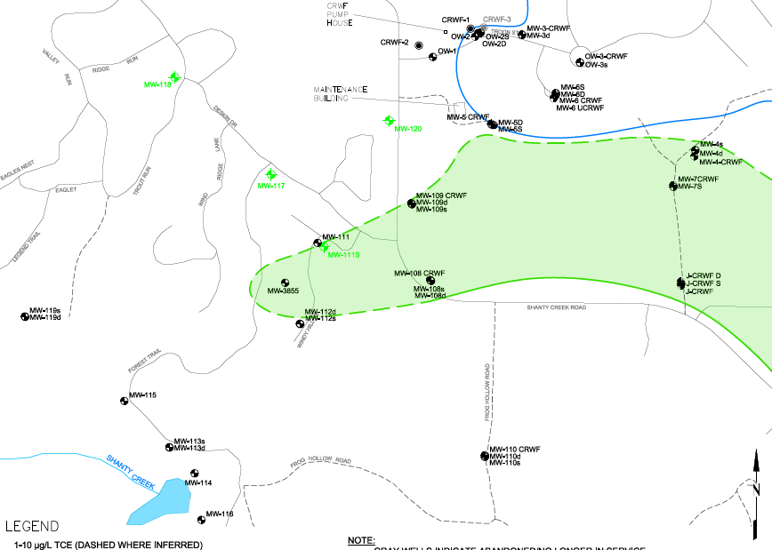
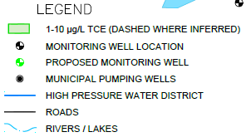
Staying Ahead of the Plume
2021: Expand sentinel wells with nested wells MW-119S/D to better constrain groundwater flow/verify influence of Shanty Creek
2022: Four additional monitoring wells installed to provide sentinel wells (TCE) and great hydraulic control
Minimize future drilling by converting residential wells where TCE has been detected to monitoring wells.
2022 NEW MONITORING WELL

Slide 14
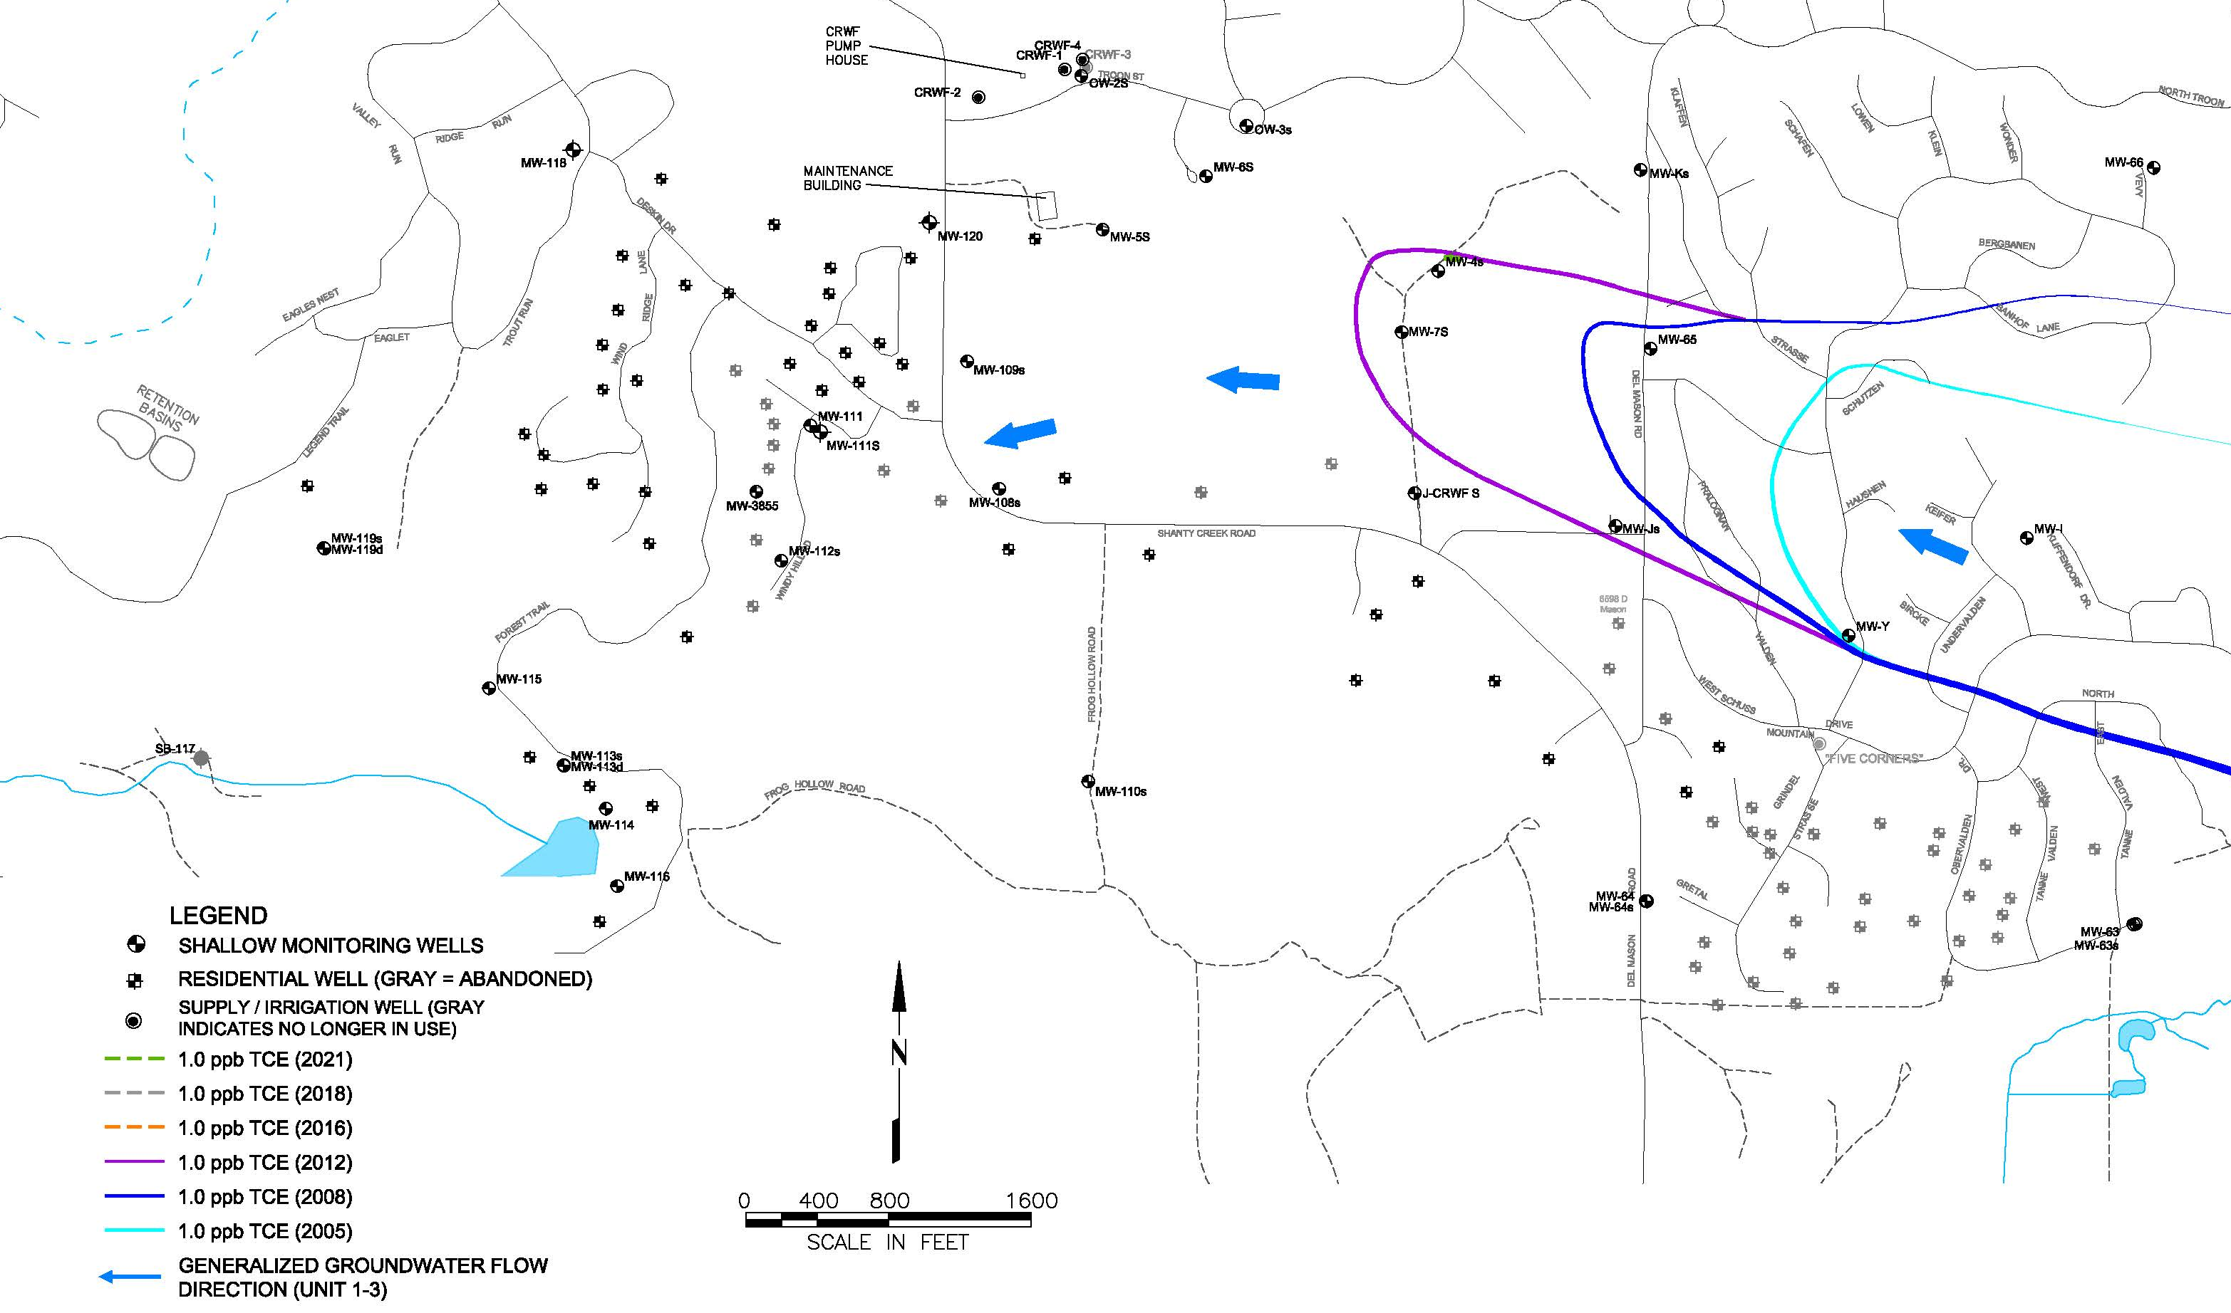
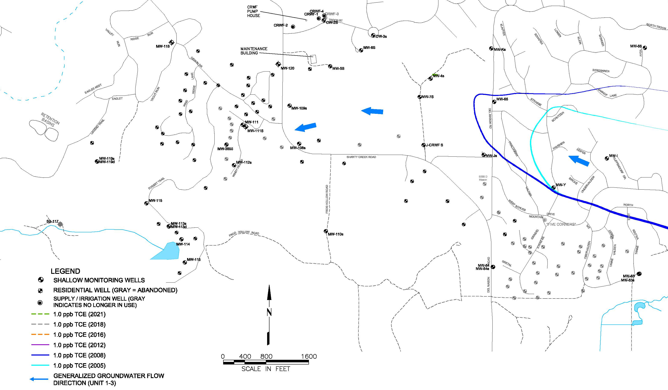
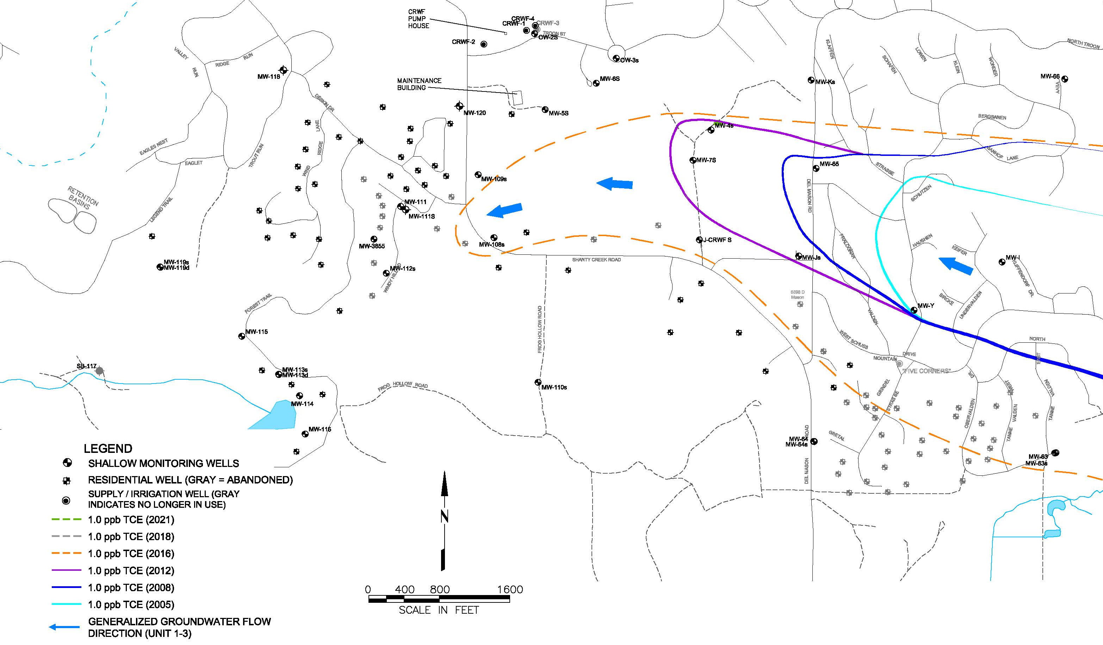
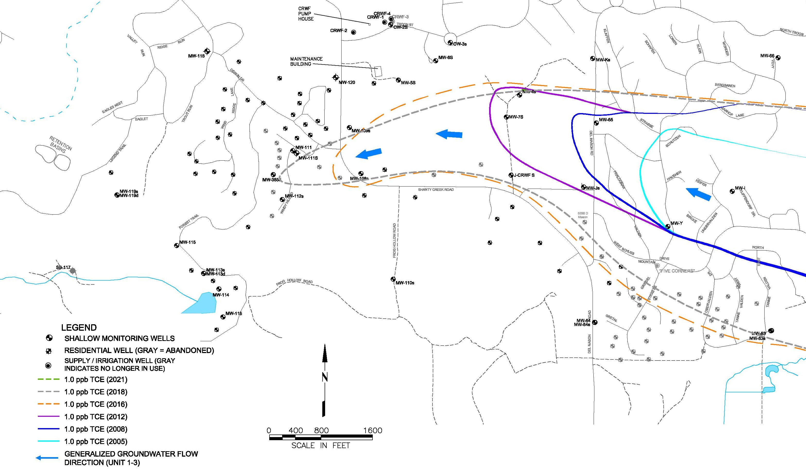
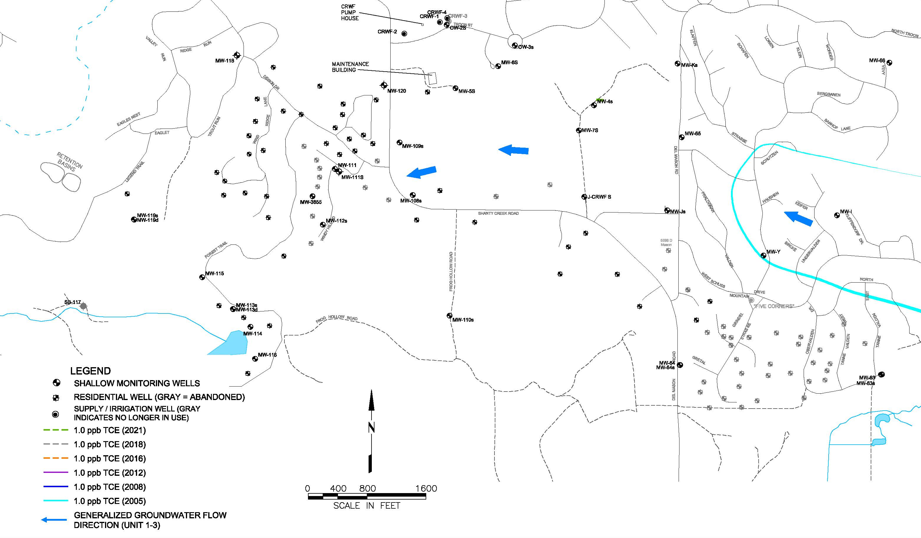
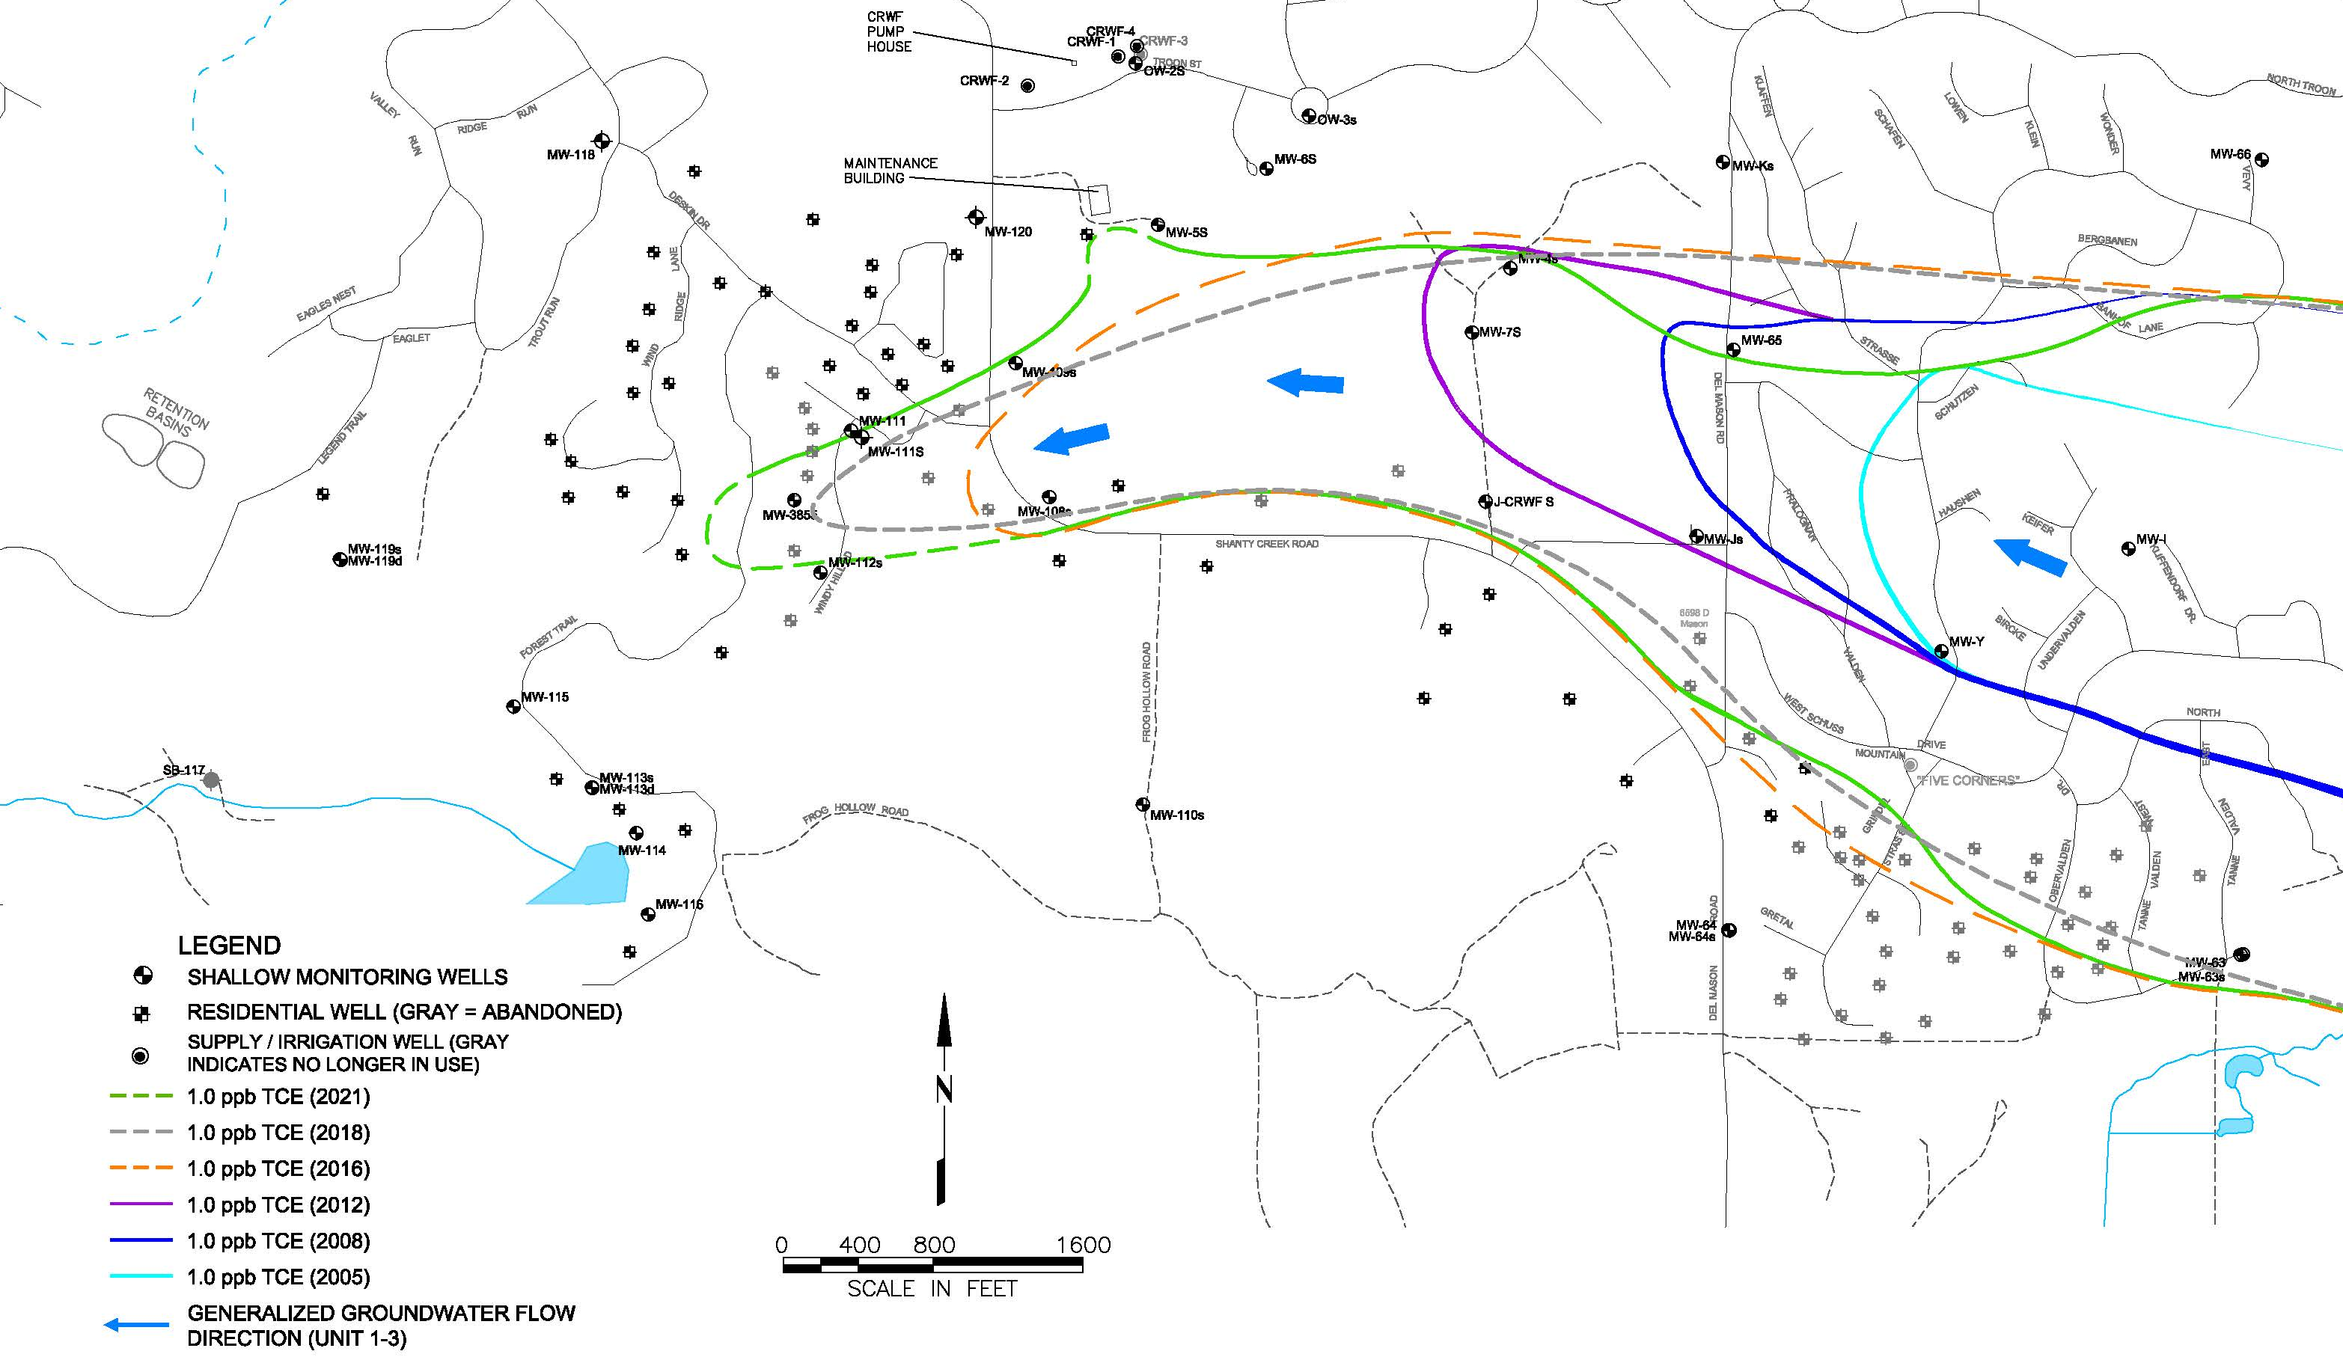
Shallow Groundwater – West Plume Expansion
First detections of TCE in monitoring or supply wells used to generate contours
Average expansion rate of 300 to 400 feet per year
2022 Confirmed Detection
2022 First Detections
Priority Areas
New detections of TCE in Summit Village in 2022
2021
2018
2016
2012
2008
2005

Slide 15
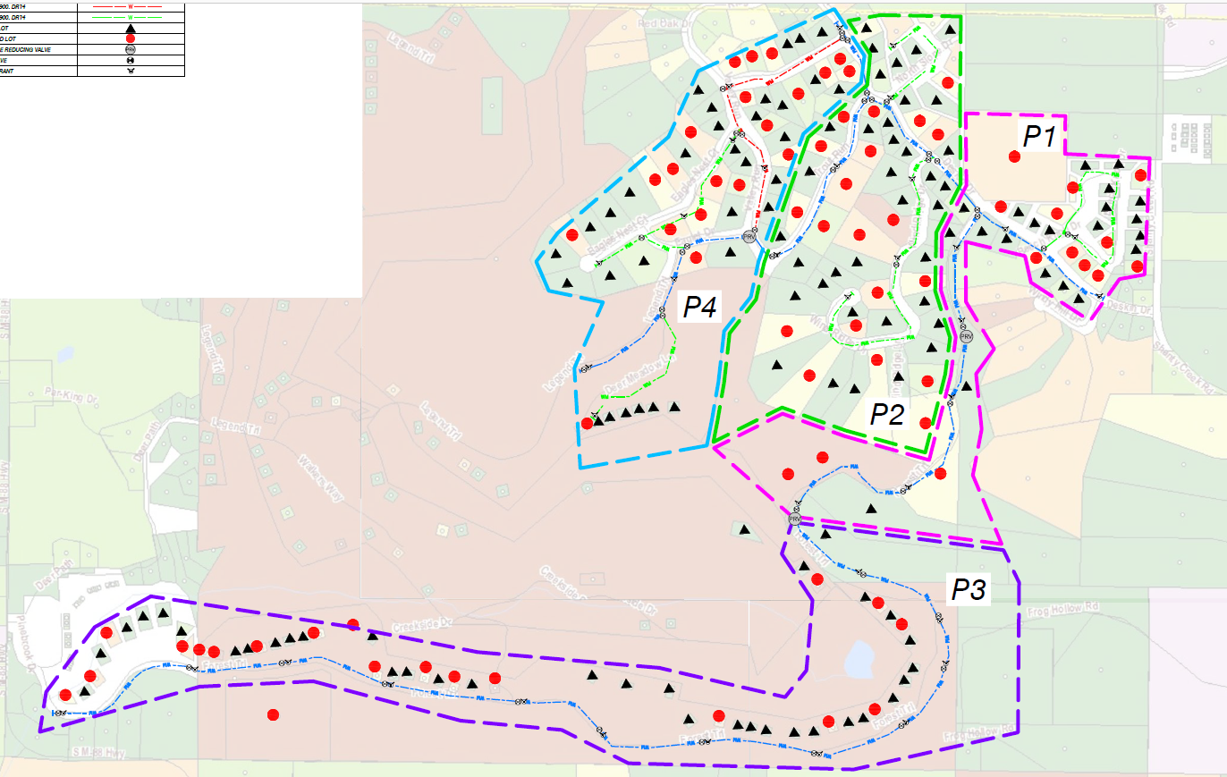
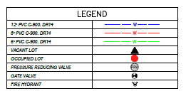
Summit Village - Phased Approach
Funding is secured for Phase I-II
Phase I – Priority expansion of existing MAWSA infrastructure along Deskin Drive to Beacon Hills and Forrest Trail
Phase II – Priority expansion along Deskin Drive to Windy Ridge, Trout Run and North Slope Drive
Phase III and IV based on projected plume migration
Additional waterline expansions to include Mary Dale Lane (near Schuss Mountain Drive/Cedar River area, not depicted)
Service to be provided to existing homes
EGLE will abandon residential wells or, at select locations, convert for use as a monitoring well (with owner permission).
North Slope Dr.
Eagles Nest Ct.
Trout Run
Beacon Hills.
Windy Ridge Dr.
Deskin Dr.
MAWSA Service Here
2022 First Detections
Derr Meadow Lane
Deskin Dr.
Forrest Tr.

Slide 16
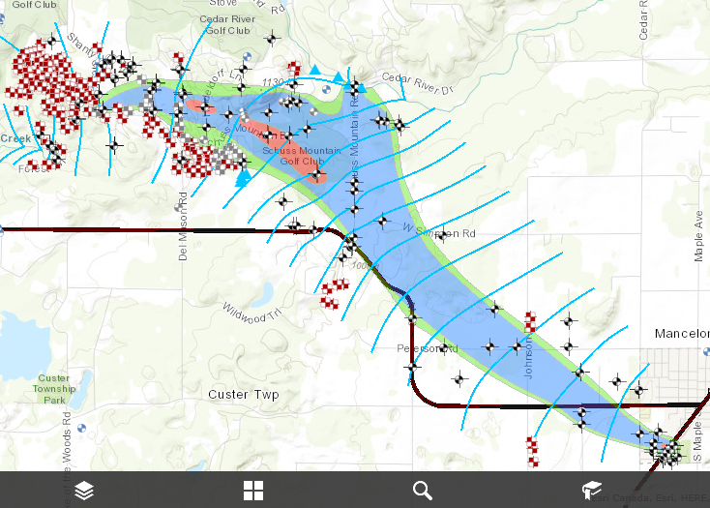
Stay Informed
Future public meetings
EGLE Fact Sheets & Reports
Available through the HDNM, Antrim County, Mancelona Township & Bellaire Public Libraries and EGLE
Online Mapping Application
https://ifrastructure.amecfw.com/wickes/

Slide 17
Michigan Department of
Environment, Great Lakes, and Energy
800-662-9278
Michigan.gov/egle
Follow us at: Michigan.gov/egleConnect

Slide 18
Additional Resources
Follow us at: Michigan.gov/egleConnect

Slide 19
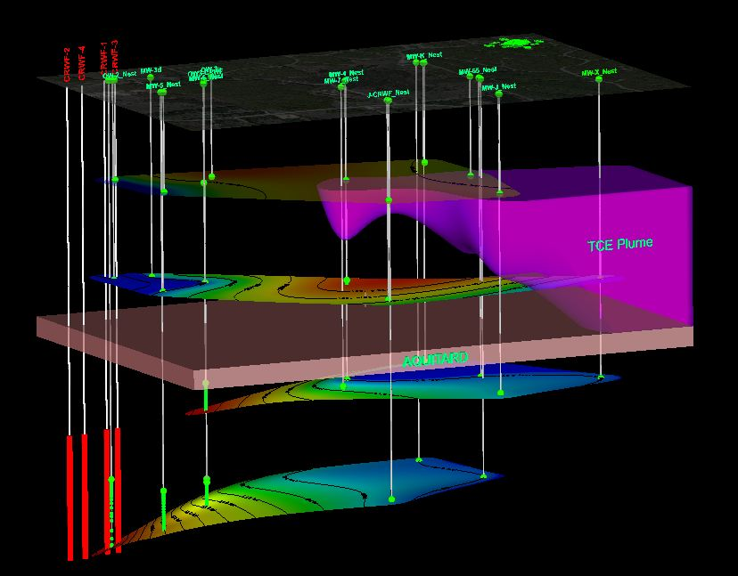
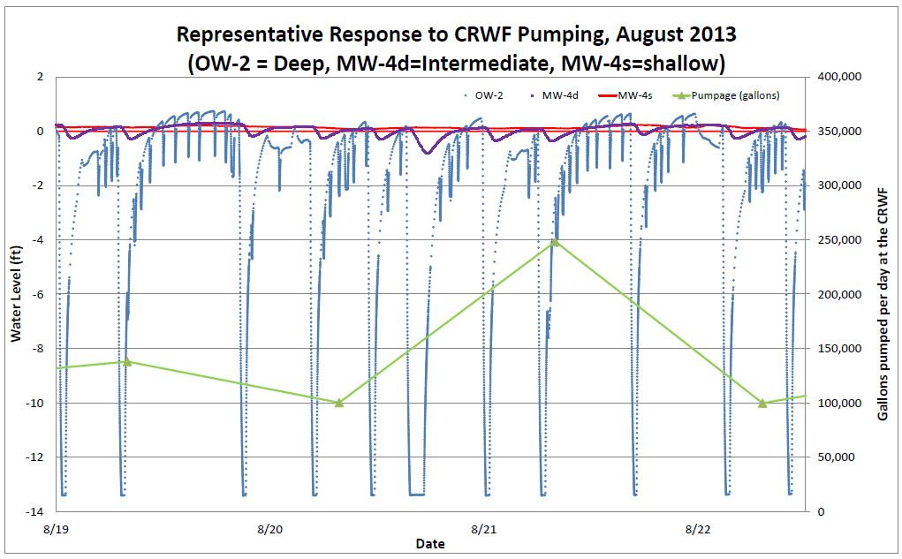
CRWF Transducer Studies
Measure Drawdown Response during high volume pumping (hydrant flush)
Some (<1 ft) pumping-related drawdown observed in intermediate zone
No discernible correlation between pumping and water level changes in shallow zone.
Results: Decreased pumping stress (high pressure waterline from Mancelona and tank storage) will reduce risk of broad contaminant migration into CRWF Aquifer.
N
Troon Rd.
Del Mason Rd
<0.1’
Shallow
<1’
Intermediate
Deep
>6’
CRWF
>13’

Slide 20
Past Site Use and Environmental Investigations
SITE
SITE
From upnorthlive.com - archive

Slide 21
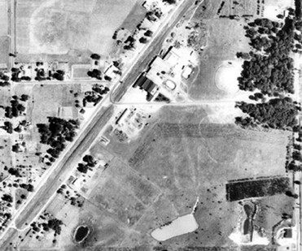
1962 Aerial Photograph
Former plating division employee indicated:
The open pit lagoon would seal itself off on the bottom causing wastewater to back up. The plant would periodically lower dynamite down to the bottom to blast it open and allow the pond to drain.
FORMER UNTREATED WASTE SEEPAGE LAGOONS
FORMER FINAL EFFLUENT POND

Slide 22
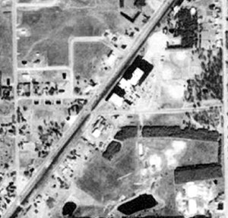
1981 Aerial Photograph
USE OF UNTREATED WASTE SEEPAGE LAGOON DISCONTINUED IN 1972
FORMER TREATED WASTE SETTLING LAGOONS
FORMER UNLINED INDUSTRIAL WASTE LANDFILL
FORMER FINAL EFFLUENT POND

Slide 23
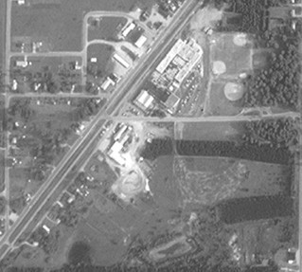
1992 Aerial Photograph
MONITORING WELLS INSTALLED BY THE EPA IN 1986
FORMER TREATED WASTE SETTLING LAGOONS AND INDUSTRIAL WASTE LANDFILL
REMOVED IN 1988/89
(SOURCE AREA REMOVAL ACTION)
FACILITY EXPANSION COVERS FORMER UNTREATED WASTE SEEPAGE LAGOON LOCATIONS
FORMER FINAL EFFLUENT POND

Slide 24
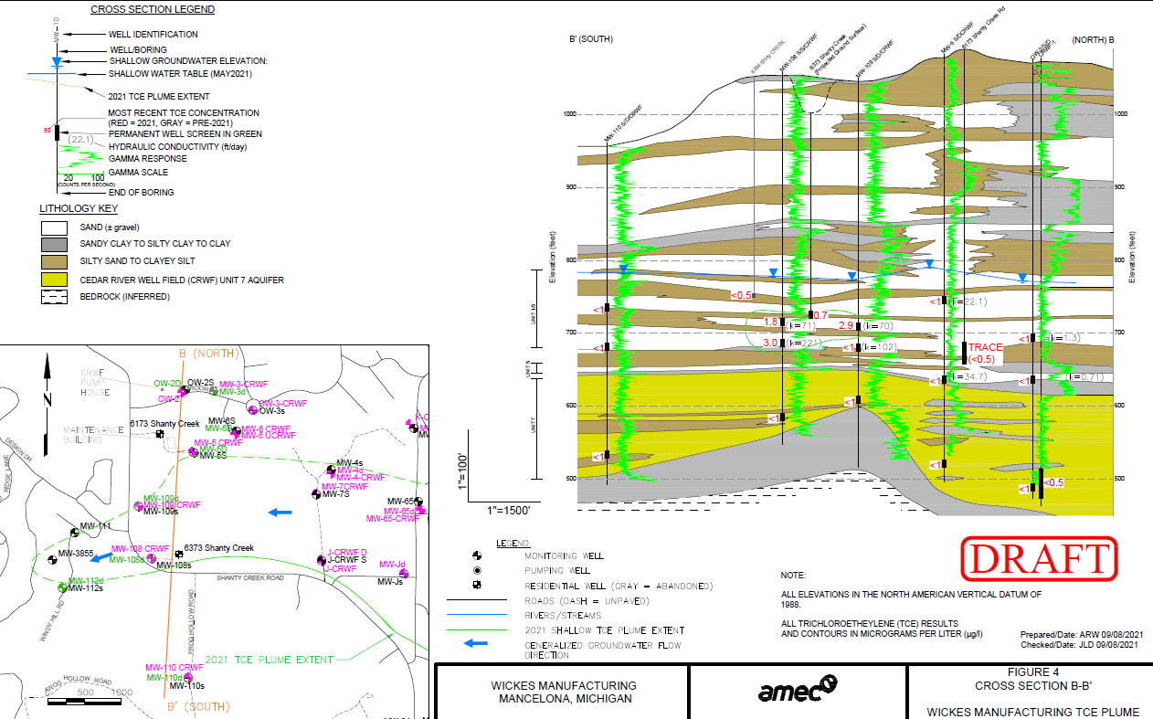
2021 Detected TCE Concentrations
6173 Shanty Creek Rd TCE = “Trace” or <0.5 ppb.
6373 Shanty Creek Rd TCE = 0.7 ppb)
MW-109S TCE = 2.9 ppb
MW-108S/D TCE = 1.8 and 3.0 ppb, respectively
MW-3855 TCE not detected (1.2 ppb in fall 2020)
The drinking water standard for TCE is 5 ppb
TCE was not detected in the CRWF Aquifer at these locations
ppb = parts per billion

Slide 25
The Well First Policy
Policy prevents the installation of new wells where public water is available.
Where public water is not available, the policy outlines requirements for well construction and sampling:
Targeted well depth zones to avoid plume
Specifications for well drilling, construction and development
Water quality sampling requirement (TCE)
Mandatory well final inspection prior to use
Connection to public water if/when it becomes available
Well abandonment. Conversion for EGLE monitoring-only purposes allowed.
Restricts the issuance of other permits (i.e. sewage) without demonstrating compliance with Well First requirements
EGLE supports the HDNW to determine targeted wells depths for requested permits

Slide 26
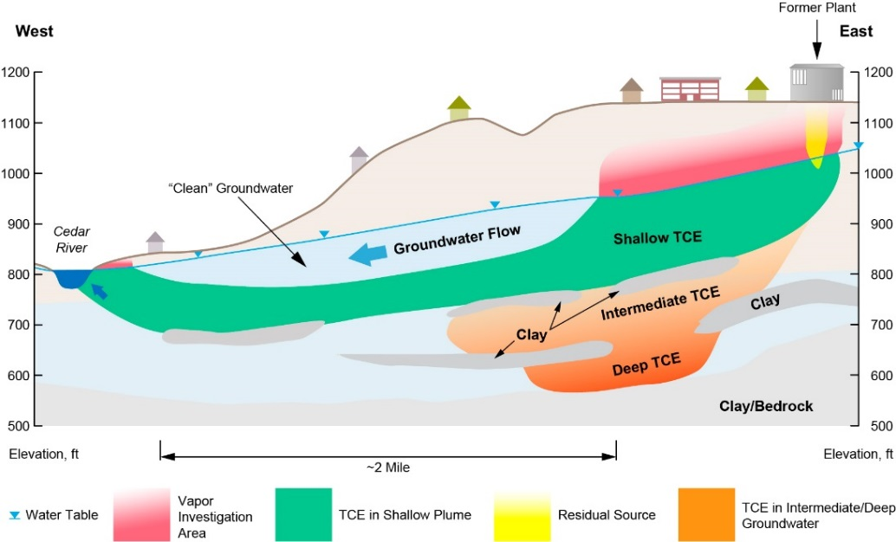
VIAP Conceptual Site Model
Source area TCE
Low level residual sources in soil
Impacts at water table
Volatilization of TCE from the groundwater plume away from the plant
Limited extent of TCE at the water table
Vertical gradients near groundwater venting areas bring TCE impacted groundwater up

Slide 27
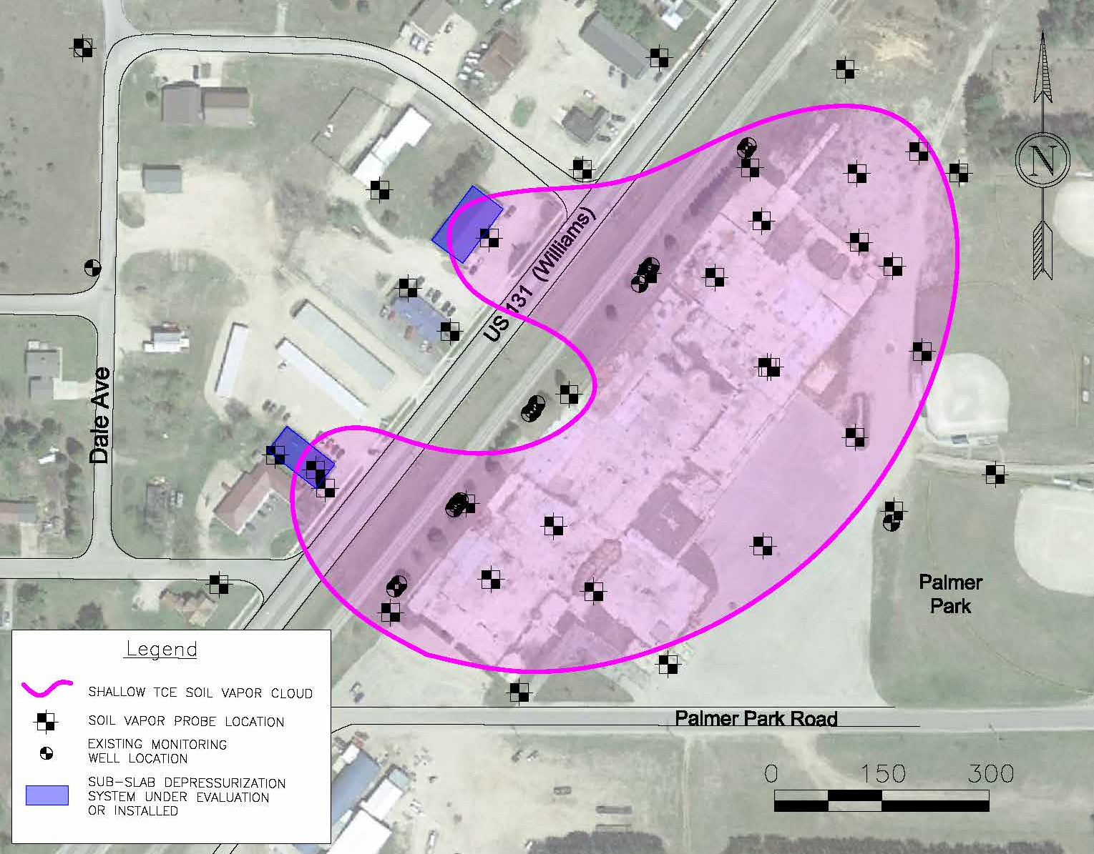
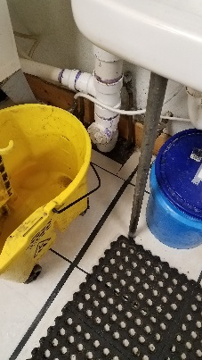
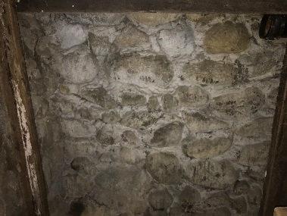
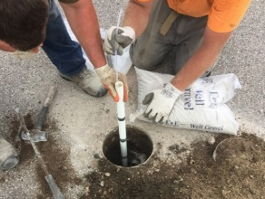
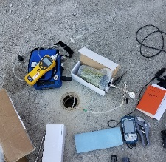
Source Area Vapor Assessment
Seasonal vapor investigations conducted at former plant and surrounding properties since 2017
TCE vapors are highest below the former plant building and TCE levels typically increase near the water table
Paired sub-slab and indoor air sampling & VIAP building assessments offsite
Where the pathway is potentially complete, mitigation measures are implemented to prevent soil vapor intrusion into buildings:
Sealing of floors, joints and/or cracks
Sub-slab depressurization systems (SSDS)
Building assessments
Preferential pathway (sewers/pipes)
Low level volatile screening
“Michigan basement“ sealing prior to SSDS testing, design & install
Installing and
sampling vapor points

Slide 28
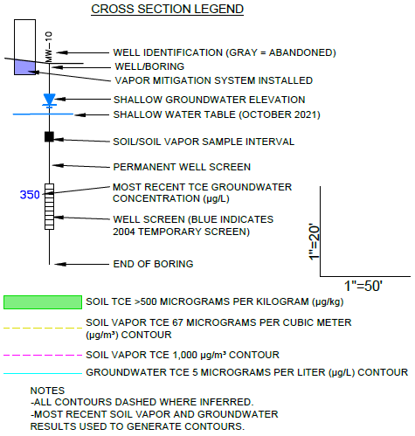
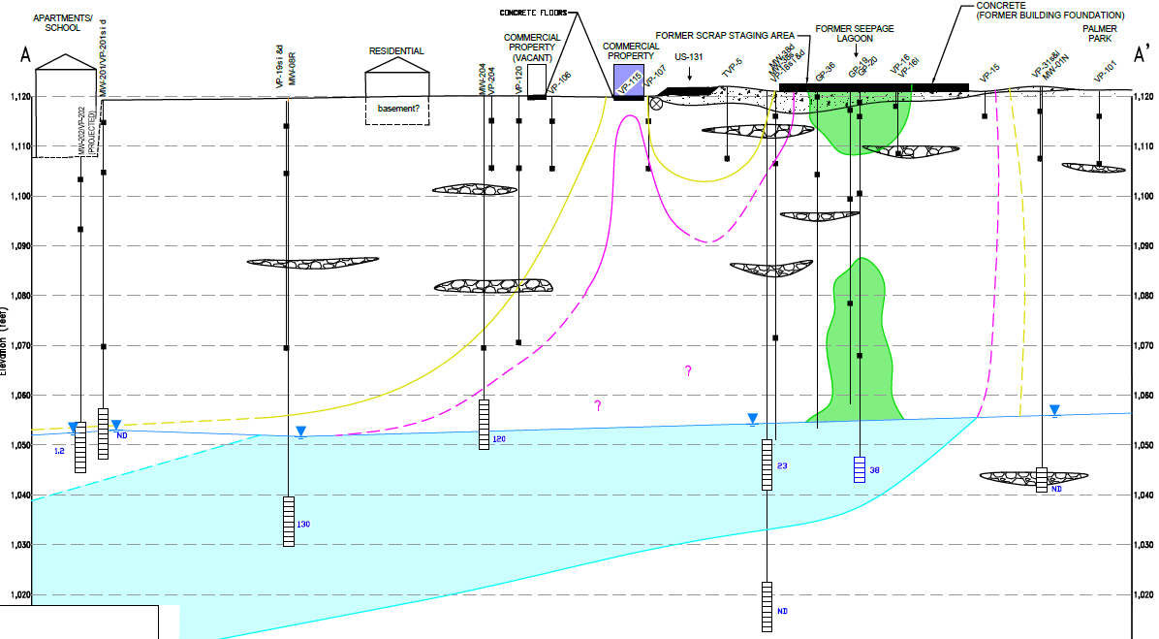
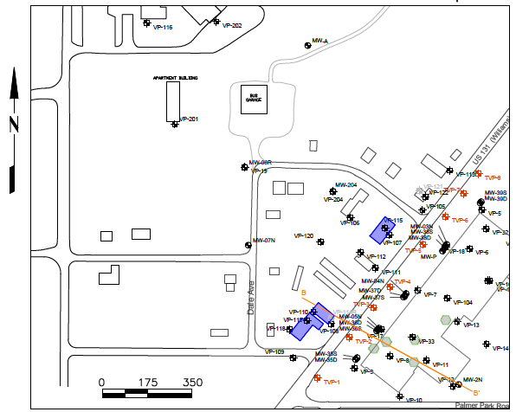
VIAP Source Area Conceptual Site Model
A
A’

Slide 29
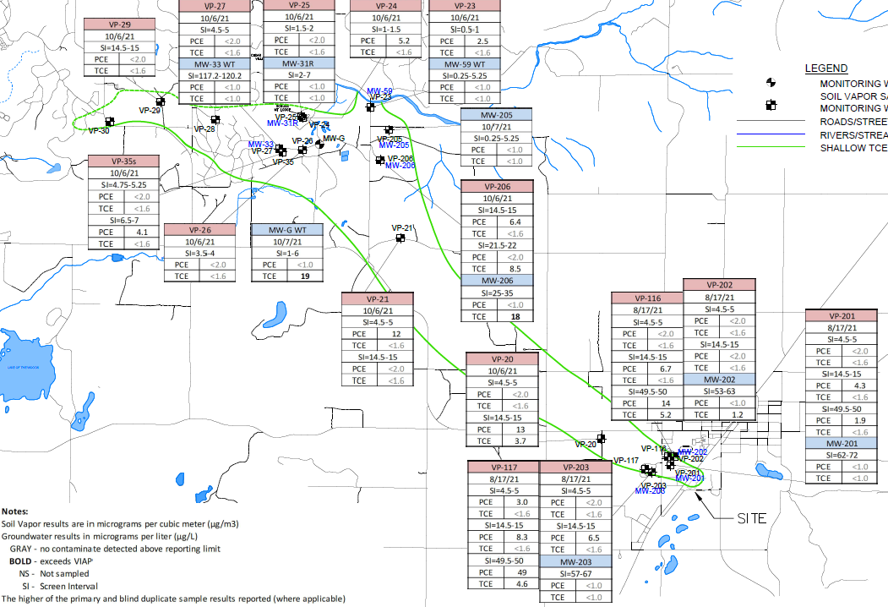
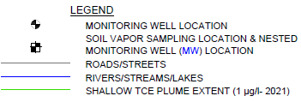
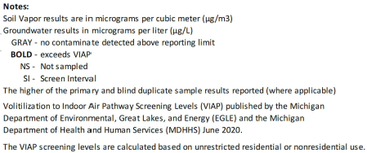
Soil Vapor and Water Table Sample Collection Downgradient, Along Plume Axis
Here, the VIAP is driven by TCE at the water table. Since TCE occurs primarily below the water table, investigations are focused.
15 Existing Soil Vapor Monitoring Locations. In 2022:
– New points in Mancelona (3)
– New points downgradient (3)
Nine existing water table wells to assess whether TCE is present in groundwater. In 2022:
– New wells in Mancelona (2)
– New wells downgradient (4)
To date TCE has not been detected in this network above the Soil Vapor VIAP Screening Level
lower topography
water table is closer to surface
potential for “venting”

Slide 30
Ongoing VI Assessment/Actions
TCE levels are continuing to be measured seasonally in soil vapor to assess the VIAP at occupied buildings near the Site and above portions of the downgradient plume where TCE may occur at or close to the top of the water table.
When TCE in soil vapor exceeds vapor intrusion screening levels near a building:
- EGLE installs vapor monitoring points to assess “sub-sab” soil vapor below the building
- Collects quarterly sub-sab soil vapor and indoor air samples (to assess seasonal conditions)
- If warranted, installs an SSDS to prevent soil vapors from entering the building
EGLE is installing six new soil vapor points and six new water table wells in 2022
EGLE has installed Sub-Slab Depressurization Systems (SSDSs) at three offsite properties
SSDSs, vapor barriers and/or other engineering controls will be needed to safely develop the former plant property.

Slide 31
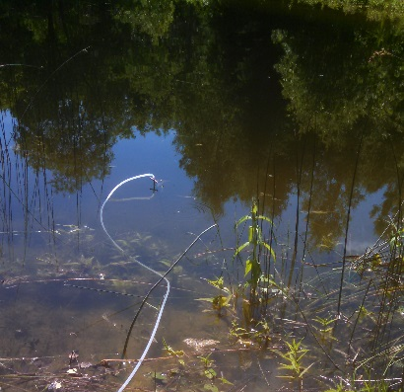
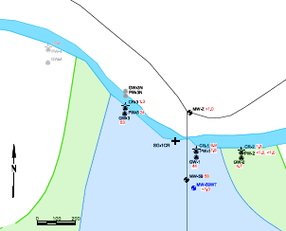
TCE Plume Venting at the Cedar River
Routine Cedar River sample collection (groundwater and surface water) has demonstrated that TCE impacted groundwater vents to the Cedar River
TCE is not detected in downstream river samples because TCE moves from the river to the air readily.
TCE has/is not detected across the river from the plume (pore water, monitoring well and VAS).
Biological surveys find no adverse affects on the river’s ecology.
TCE in groundwater near the Cedar River is well below 200 ppb.

Slide 32
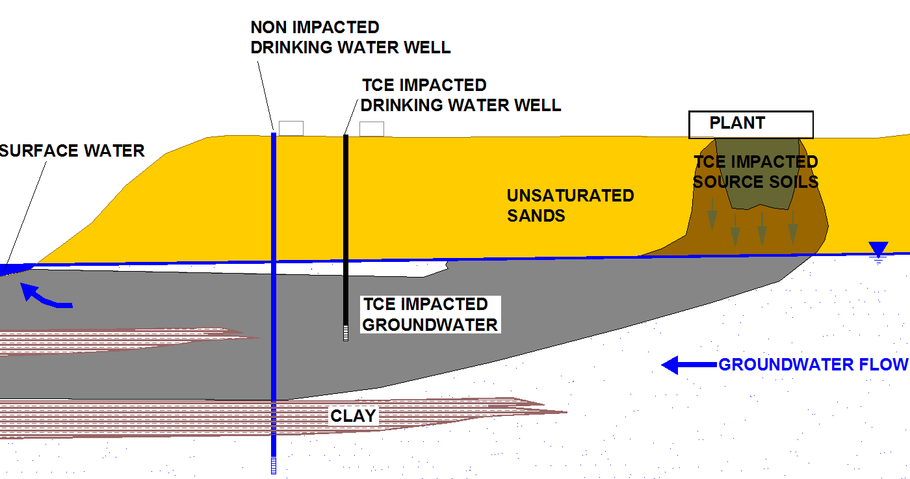
Conceptual Site Model
Potential Exposure Pathways:
Soil Exposure (Site)
Surface Water: Cedar River Shanty Creek
Drinking Water: Downgradient residential / municipal wells
Vapor Intrusion

